Slide 1

Introduction to atmospheric pollution
Dr. Zeinab Salah Mahmoud
Egyptian Meteorological Authority

Slide 2
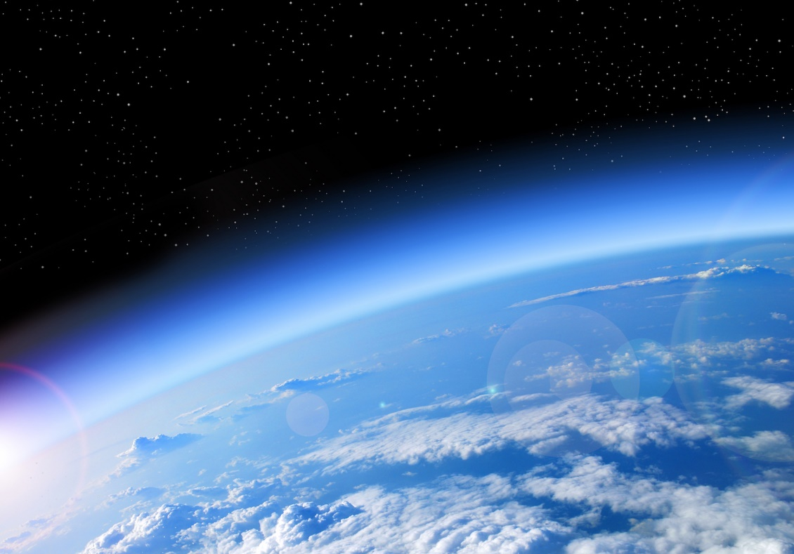
The Atmosphere
The atmosphere is a thin layer covering the Earth.
About 80% of the atmosphere is found at the lowest altitude of 20 km above the Earth's surface.

Slide 3
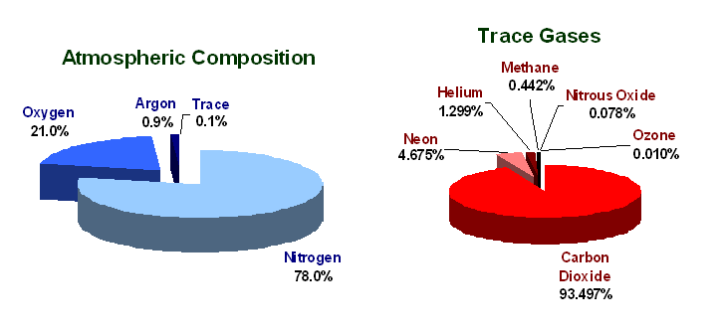
The Atmosphere
It consists of a mixture of:
Permanent gases - make up a fixed proportion of the total mass of the atmosphere.
Variable gases - their distribution and concentration vary in space and time.
Aerosols - suspended particles and liquid droplets.

Slide 4
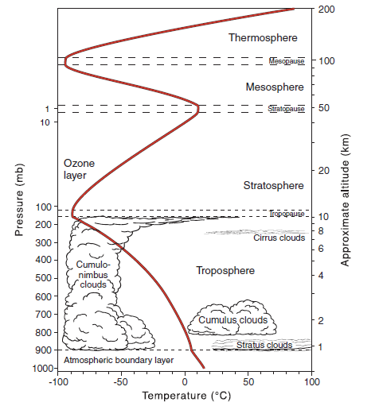
Atmospheric Layers
Atmospheric layers defined by changes in temperature:
Troposphere – contains 75% of atmospheric gases; temperature decreases with height
Tropopause – boundary between troposphere and stratosphere; location of the jet stream. Its altitude varies from ~8 km (Poles) to ~17 km (Tropics)
Stratosphere – contains the ozone layer, which causes the temperature to increase.
Mesosphere – The top of this layer is the coldest place found within the Earth system.
Thermosphere – highly energetic solar radiation (UV, X-rays) absorbed by residual atmospheric gases.

Slide 5
A Brief History of Air Pollution
Very early accounts of air pollution characterized the phenomenon as “smoke problems,” the major cause being people burning wood and coal to keep warm.
In 1873, nearly 700 people died from a thick mixture of smoke and fog that came over London.
Another in 1911 claimed the lives of 1150 Londoners, and the physician, Harold des Voeux named smog to describe the combination of smoke and fog.
During the first week of December, 1952, a major disaster struck. The winds died down over London and the fog and smoke became so thick that people walking along the street literally could not see where they were going. This particular disastrous smog lasted 5 days and took nearly 4000 lives.

Slide 6
During the winter of 1930, Belgium’s highly industrialized Meuse Valley experienced an air pollution tragedy when smoke and other contaminants accumulated in a narrow steep-sided valley. The tremendous buildup of pollutants caused about 600 people to become ill, and ultimately 63 died. Not only did humans suffer, but cattle, birds, and rats fell victim to the deplorable conditions.
During October, 1948, when industrial pollution became trapped in the Monongahela River Valley, Donora, Pennsylvania, USA. During the ordeal, which lasted 5 days, more than 20 people died and thousands became ill.
Photochemical smog: one that forms in sunny weather and irritates the eyes.

Slide 7
Air Pollutants
They are gases, liquids, or solids suspended in the air in high enough concentration to affect human, animal, or vegetation health. They are be classified to different types
According to sources:
They come from both natural sources and human activities.
Natural sources include wind picking up dust and soot from the earth’s surface and carrying it aloft, volcanoes belching tons of ash and dust into our atmosphere, and forest fires producing vast quantities of drifting smoke.
Human-induced pollution enters the atmosphere
fixed sources (ex: industrial complexes, power plants, homes, office buildings), and
mobile sources (ex: motor vehicles, ships, and jet aircraft).

Slide 8
Air Pollutants
According to composition:
Primary pollutants because they enter the atmosphere directly, such as dust, soot.
Secondary pollutants, form only when a chemical reaction occurs between a primary pollutant and some other component of air, such as ozone.
Common pollutants
Gases: CO, NOx, SO2, O3 (tropospheric)
Aerosols: dust, black and organic carbon, SO4, PM10, PM2.5, Pb, ammonium sulphate and ammonium nitrate

Slide 9
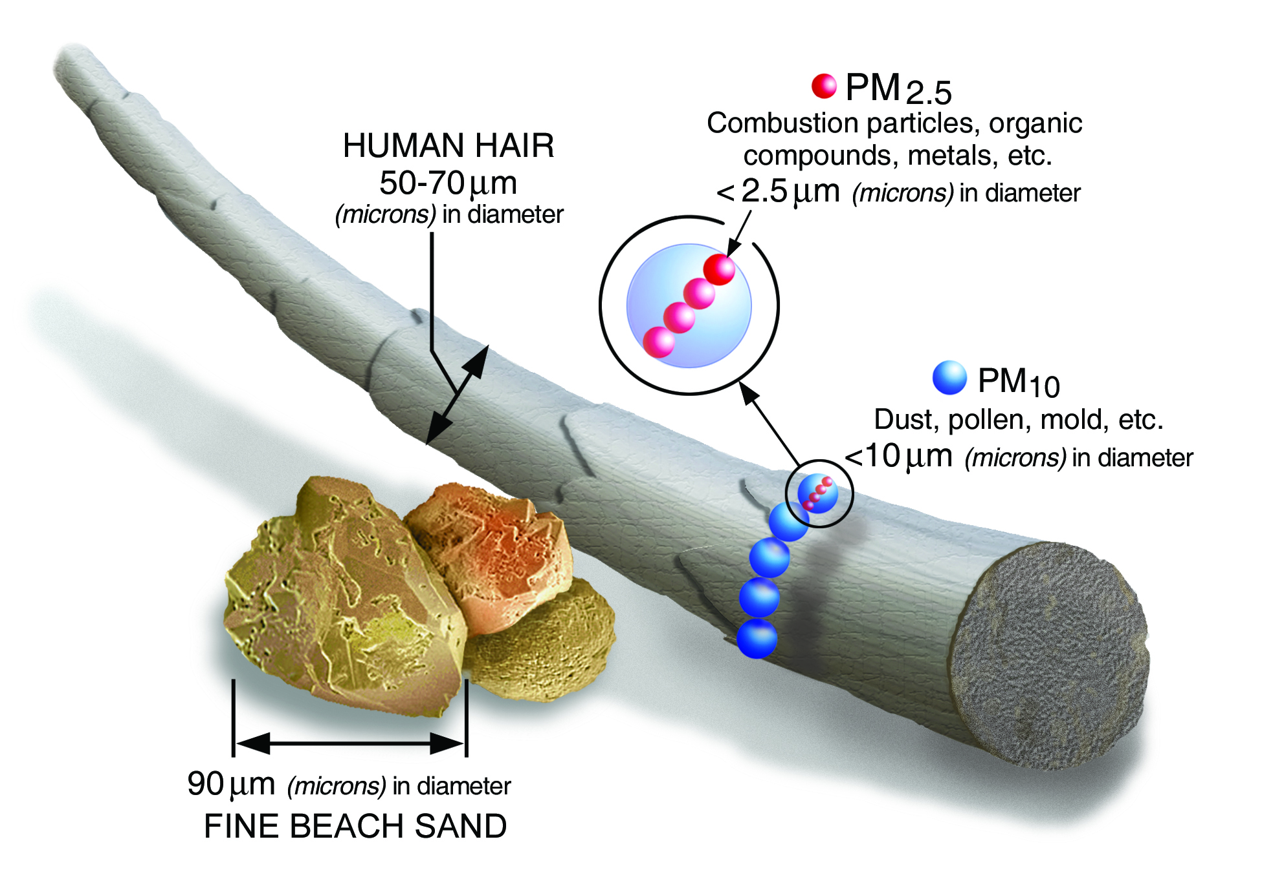
Particulate Matter (PM)
The particulate matter or aerosols: a group of solid particles and liquid droplets that are small enough to remain suspended in the air.
Some particulate matter collected in cities includes iron, copper, nickel, and lead. This type of pollution can immediately influence the human respiratory system.
PM₁₀ : inhalable particles, with diameters that are generally 10 micrometers and smaller; and
PM_{2.5} : fine inhalable particles, with diameters that are generally 2.5 micrometers and smaller.
https://www.epa.gov/pm-pollution/particulate-matter-pm-basics

Slide 10
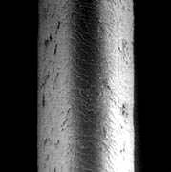


Hair cross section (60 μm)
Human Hair
(60 μm diameter)
PM₁₀
(10 μm)
PM_{2.5}
(2.5 μm)

Slide 11


PM₁₀
PM_{2.5}
PM_{2.5-10}
(diameter <10 microm)
ultrafine
<0.1 µm
accumulation
0.1 – 1 µm
Coarse
1 - 10 µm
Mineral dust :
Marine salt:
Sulfate:
Nitrate:
Organic aerosol:
black carbon:

Slide 12
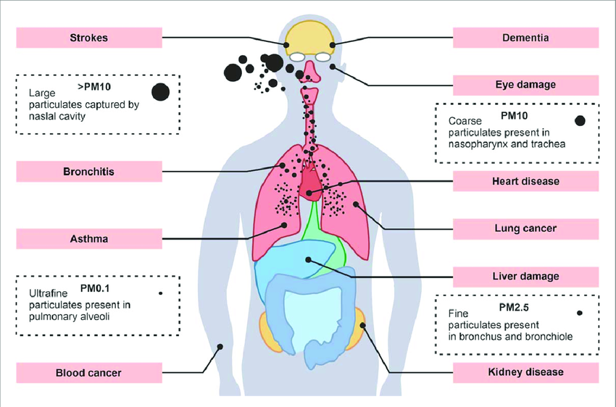
Impacts of PM on the Health
https://www.researchgate.net/figure/Health-effects-associated-with-airborne-particulate-matter-pollution_fig3_366044065

Slide 13
Aerosols & Climate
Indirect effects: change in the optical properties of clouds due to interaction with anthropogenic-aerosols
natural phenomena
rain
polluted clouds
inhibited rain
Anthropogenic aerosols effects on water clouds cause an indirect cloud albedo effect (referred to as the first indirect effect), which has a best estimate for the first time of –0.7 [–0.3 to –1.8] W m^{–2}, with a low level of scientific understanding
increase in life time of clouds
change of optical properties
change of optical properties

Slide 14
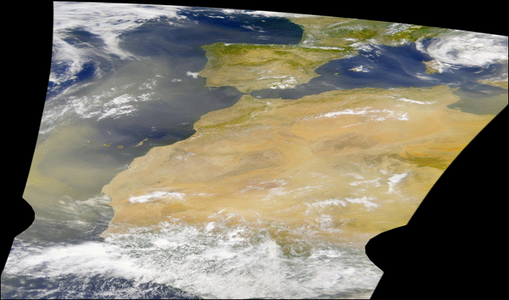
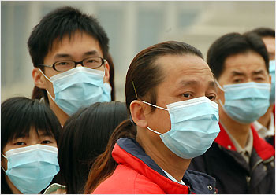
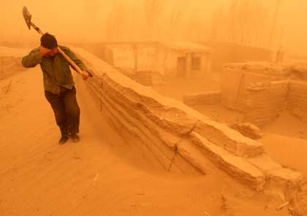
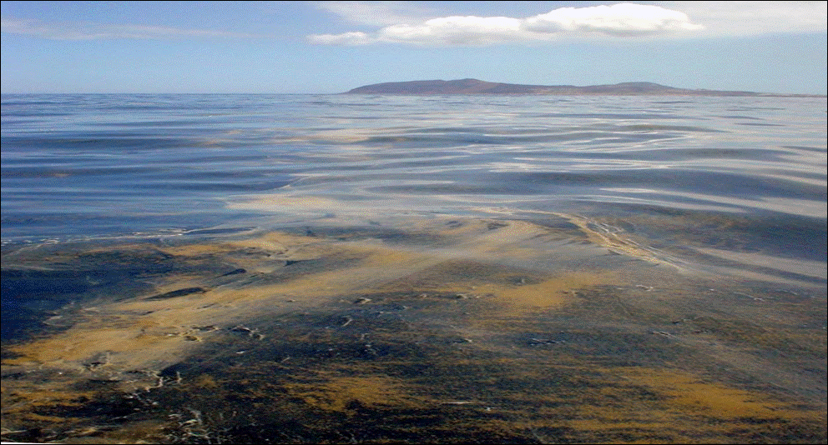
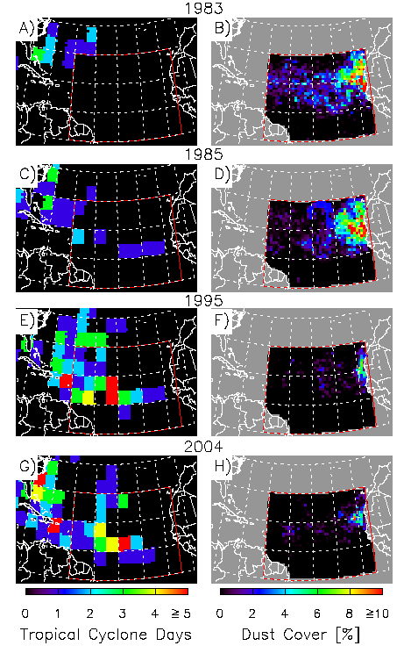
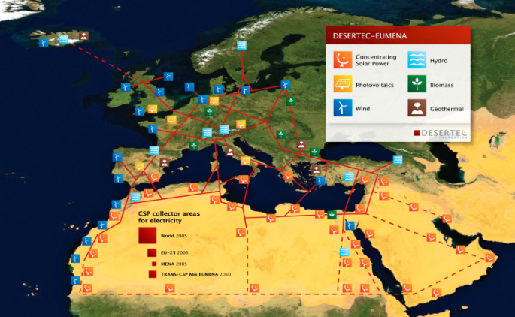
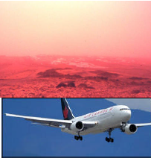
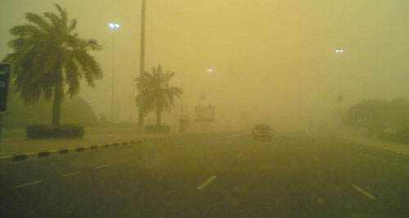
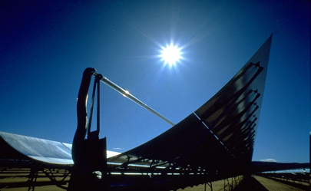
Human Health (Asthma, infections, Meningitis in Africa, Valley Fever in the America’s)
Agriculture (negative & positive impacts)
Marine productivity (negative & positive impacts)
Industry (Semi-conductor, etc.)
Energy (Thermal solar energy)
Improved Weather and
Seasonal Climate prediction
Aviation (air disasters)
Ground Transportation
Notes:
Direct:
-Cooling produced by aerosol scattering back to space of solar radiation
-Aerosol absorption of solar and longwave radiation may produce change in atmospheric heating rates, leading to changes in atmospheric circulation.
Indirect:
- changes in optical properties and lifetimes of clouds.
Non-Climate related effects
-Air pollution: local, regional and global (i.e., large scale biomass burning and boreal forest fires)
-Fertilization of the global ocean: Iron flux from desert dust and other sources
-Attenuation of surface UV-A and UV-B radiation
-Tropospheric chemistry and photochemistry: Heterogeneous chemistry processes, changes in photolysis rates
- Remote sensing of other geophysical parameters: ocean color, atmospheric ozone, surface albedo, etc

Slide 15
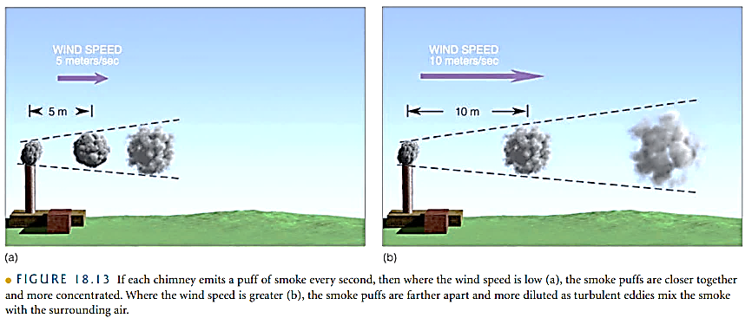
Factors That Affect Air Pollution
The Role Of The Wind
The wind speed plays a role in diluting pollution.
The wind speed determines how quickly the pollutants mix with the surrounding air and, of course, how fast they move away from their source.
Turbulent air produces swirling eddies that dilute the pollutants by mixing them with the cleaner surrounding air.

Slide 16
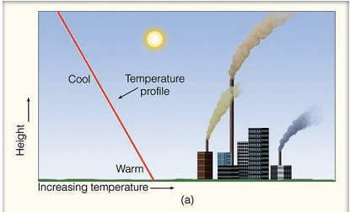
Factors That Affect Air Pollution
The Role Of Stability And Inversions
An unstable atmosphere favors vertical air currents, whereas a stable atmosphere strongly resists upward vertical motions.
Consequently, smoke emitted into a stable atmosphere tends to spread horizontally, rather than mix vertically.
The stability of the atmosphere is determined by the way the air temperature changes with height (the lapse rate).
When the air temperature decreases rapidly as we move up into the atmosphere, the atmosphere tends to be more unstable and pollutants tend to be mixed vertically.
If the air temperature either decreases quite slowly as we ascend, or actually increases with height (inversion), the atmosphere is stable. Hence, the inversion acts like a lid on vertical air motions.

Slide 17
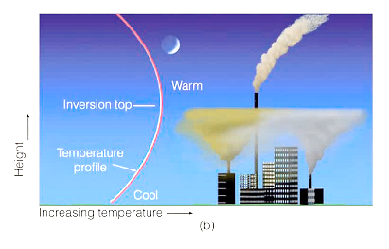
Factors That Affect Air Pollution
The Role Of Stability And Inversions:
The radiation (or surface) inversion forms during the night and early morning hours when the sky is clear and the winds are light, especially during the winter.
Within the inversion layer, the smoke from the shorter stacks does not rise very high, but spreads out, contaminating the area around it.
In the relatively unstable air above the inversion, smoke from the taller stack is able to rise and become dispersed.
In fact, taller chimneys disperse pollutants better than shorter ones even in the absence of a surface inversion because the taller chimneys are able to mix pollutants throughout a greater volume of air.

Slide 18
What property of aerosols we want to measure ?
Number Size Distribution
Mass Concentration
Chemical Composition
Mixing State
Mineralogy
Optical Properties

Slide 19
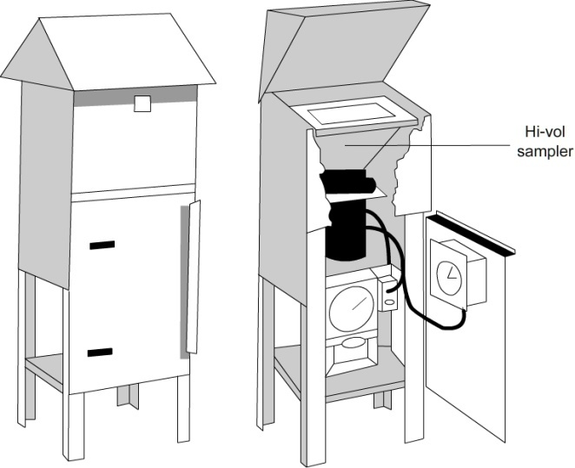
PM₁₀ and PM_{2.5} measurements in air quality networks
1) Reference method: gravimetric method
(W2-W1)
PM=
µg/m³
Volume
Blank filter
Sampled filter
Conditioning
RH (50±5%) y T(20±1ºC) 24-h
Conditioning
RH (50±5%) y T(20±1ºC) 24-h
- Filter weight (W1)
- Filter weight (W2)
Pump

Slide 20
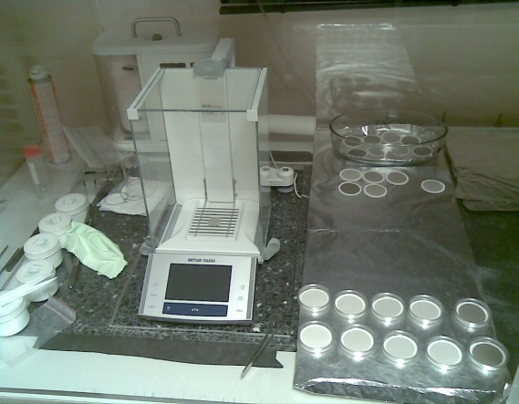
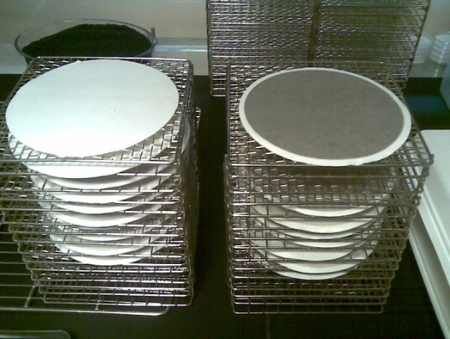
Common Gravimetric Ambient Aerosol Sampling Techniques
High volume methods: TSP, PM₁₀, PM_{2.5}
Low volume methods: (PM₁₀, PM_{2.5}, PM_{Coarse})
This sample filter is equilibrated at some set of thermodynamic conditions for a period of time before and after sampling. Through the use of a laboratory gravimetric balance, the difference in pre- and post-sample weights yields the PM mass collected. Knowing the volume of air passed through the filter allows the determination of the PM mass concentration.
Advantages: Recognized reference method, low capital cost
Disadvantages: Limited time resolution (typically 24-hr), long turnaround times, labor intensive, and gravimetric lab maintenance/cost.

Slide 21
2) Automatic continuous measurements
TEOM :Tappered Element Oscillating Microbalance
1. TEOM mod.1400a
mass=function (frequency)
sensor
Sampling flow rate (16.67 l/m)
Sample accumalated in the filter
Micro-oscilation of constante amplitue GENERATOR
Frequency sensor
Flow exit
An increase in the amount of sample (dust) accumulated in the filter ➔ decrease in the oscillation frequency

Slide 22
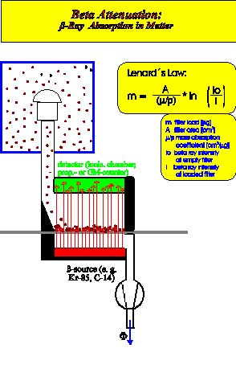


PM with Beta atenuation (1)
Krypton-85 or Carbon-14 is used as source of beta radiation (emitted by electrons during the nuclear decay of radioactive elements).
Ambient air is drawn through the sample system
Beta rays detector
Beta rays source (Kr-85)
Dust is deposited on a filter continuously. The layer of dust is building up and this increasing dust mass weakens the intensity of the beta beam.
Pump and flowmeter

Slide 23
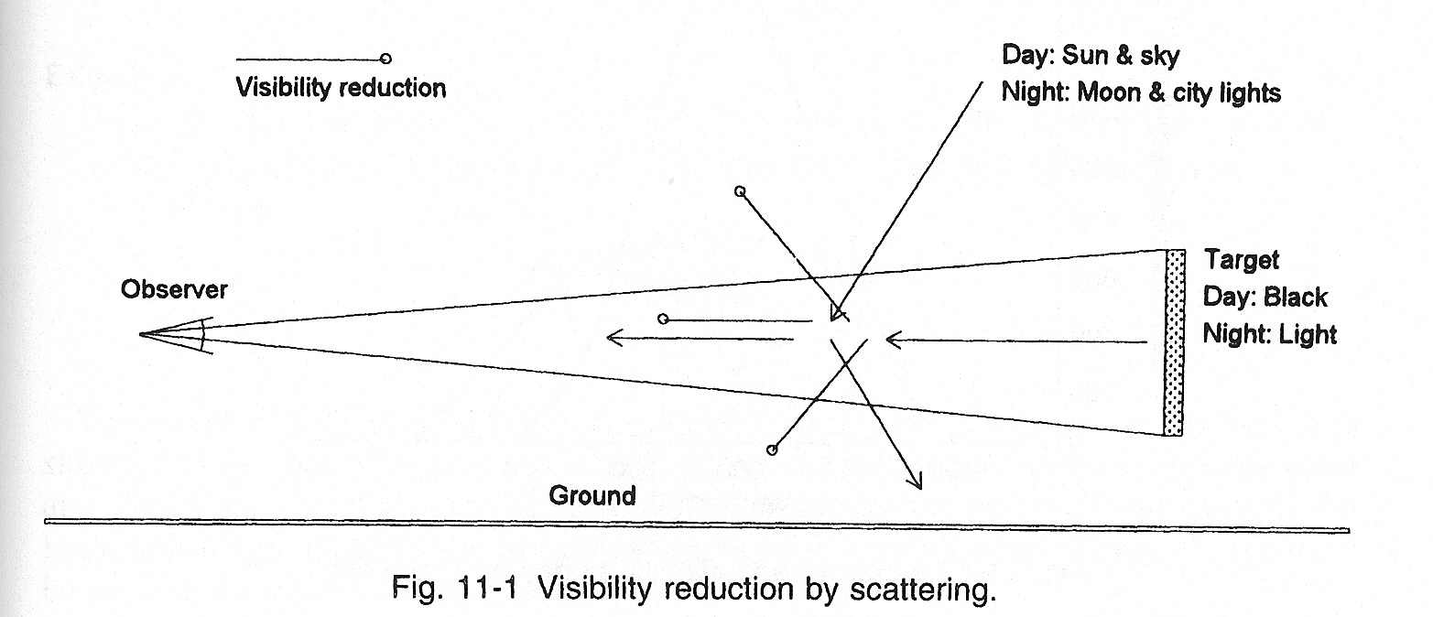
Aerosols Estimation using visibility
The greatest distance that a black object of “suitable dimensions,” situated near the ground, can be seen and recognized when observed against a background of fog
Aerosols are the main cause of visibility reduction
Operational surface synoptic weather station reports from Global Telecommunication System (GTS)
Station reports include past and present weather, visibility (km), temperature (°C), dew point temperature, wind direction (°), and speed (knots)

Slide 24
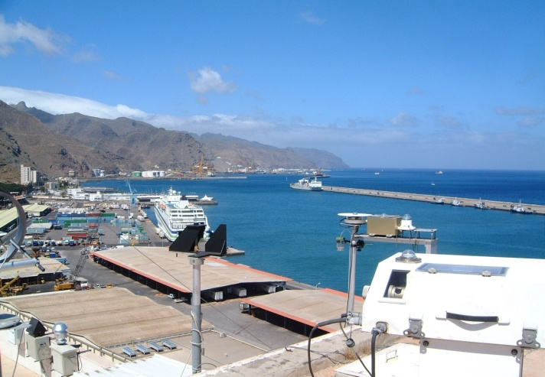
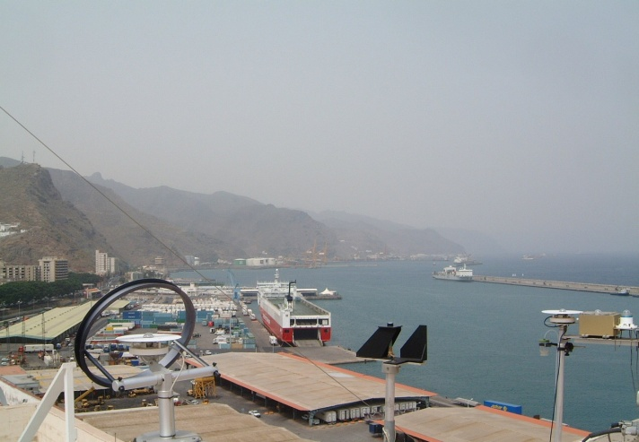
Santa Cruz Tenerife
PM₁₀<15μgm⁻³
Santa Cruz Tenerife
PM₁₀>60μgm⁻³

Slide 25
Problems with station visibility estimates
Human observations are inherently subjective.
No all reductions of visibility are due to dust (fog, biomass burning…)
Coarse reporting bins
Judgment in distinguishing visibility beyond 10 km
Main advantages
Reports are abundant and widespread over land. There is information in remote areas (deserts)
There are some standards
Human detected visibility has been correlated well with surface extinction analyses (Husar et al., 2000)
Estimations of PM are possible

Slide 26
Ground-based remote sensing
Knowing the sunlight's energy at the top of the atmosphere, the thickness of the atmosphere, and the amount of sunlight transmitted to the earth's surface and can allows us to determine the amount of scattering, and thus, the amount of aerosols (dust).
The intensity of sunlight at the top of the earth's atmosphere is constant. While the sunlight travels through the atmosphere, aerosols can dissipate the energy by scattering and absorbing the light.
More aerosols in the atmosphere cause more scattering and less energy transmitted to the surface.
Sun
I₀
Atmosphere
l
C, α
I₁
(I₀ >I₁)
Sunphotometer
Beer’s Law
Transmissivity (T)
Extinction coefficient (σext): εC
path length (L)
molar absorptivity of the absorber (ε)
concentration of absorbing species in the material (C)
I=I_{o}·e
- σ_{ext·}L
Notes:
Briefly discusses already, but in detail here- and stating it twice is good for emphasis. Stress that detectors are inside a case so that sunlight can enter only through a small hole. Otherwise, the detectors would see both direct sunlight and "sky light", which is essentially sunlight scattered by air molecules in the atmosphere.

Slide 27
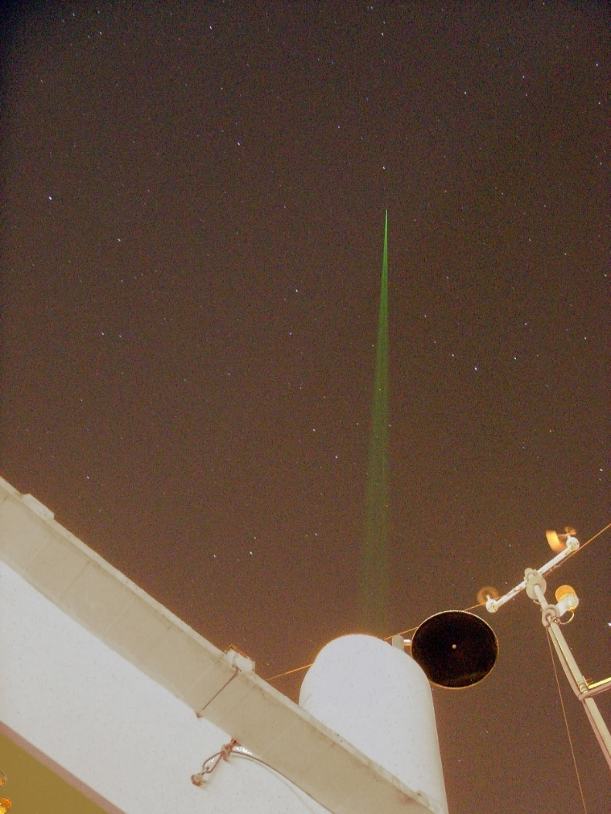
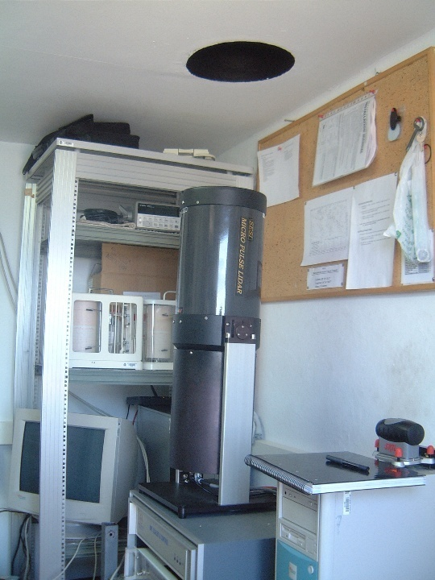
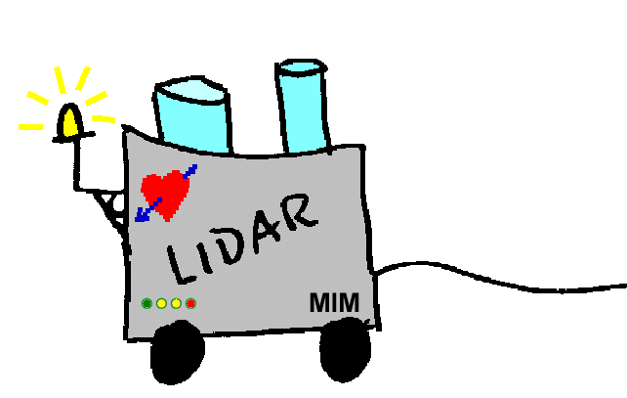
LIDAR: Light Detection and Ranging.
Scattering on aerosols (and molecules)
in all directions, some photons back
Emitted pulse
backscattered
photons
Telescope
Laser
Taken from Matthias Wiegner‘s presentation (University of Munich, Meteorological Institute) to the SPIE 10 (International Symposium Remote Sensing)
Lidar-Tenerife (INTA-AEMET); Elastic lidar
MPLNET

Slide 28
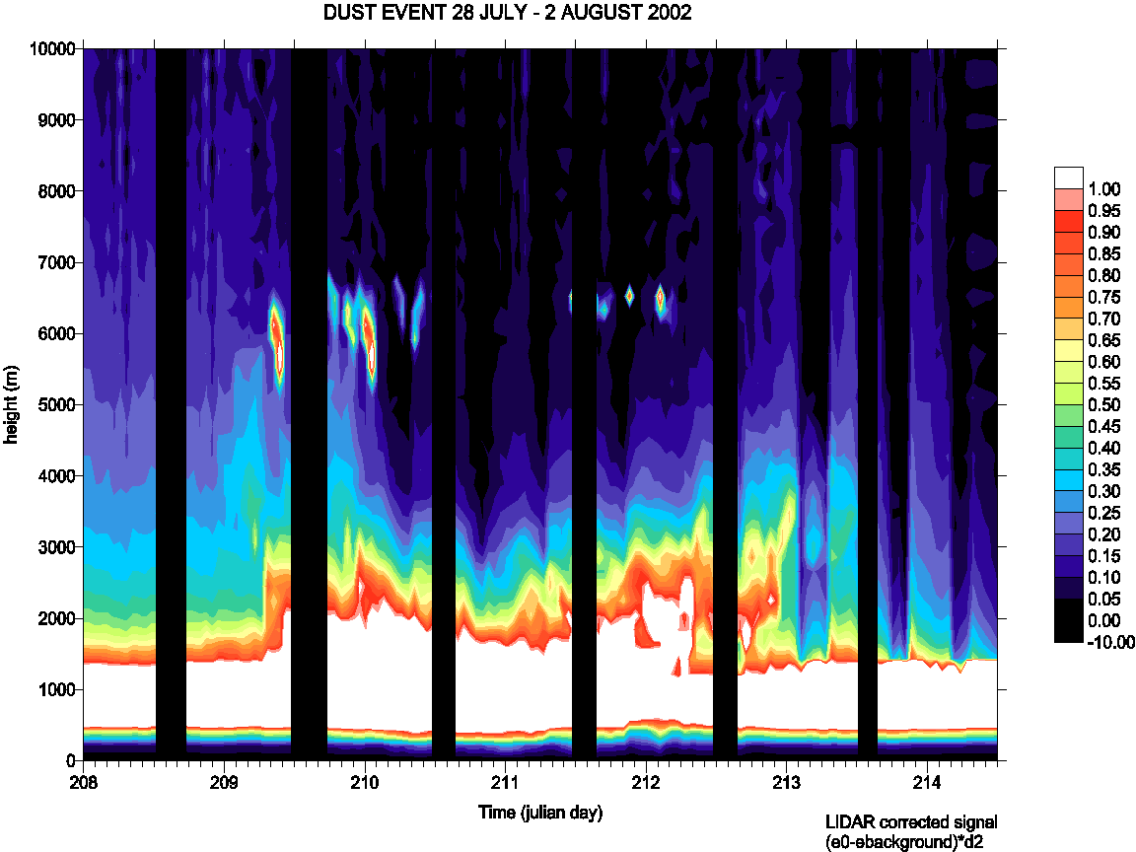

MPL-Tenerife
Atocumulus
Saharan air layer
Top of the marine boundary layer

Slide 29
How Satellites Detect Aerosols:
Aerosols change the way sunlight travels through the atmosphere. Satellites detect these changes in reflected, scattered, and absorbed light.
Main Measurement Principles
Scattering – Aerosols scatter sunlight in all directions; the scattering amount and pattern depend on particle size and composition.
Absorption – Some aerosols (dust, smoke, soot) absorb certain wavelengths, reducing the light reaching the satellite.
Spectral Signature – Measuring at multiple wavelengths reveals aerosol type (e.g., dust absorbs more in UV, smoke more in blue/red).
Polarization – Aerosols change the polarization of light; analyzing this gives extra clues on particle shape and size.

Slide 30
Sensor Type | Example Missions | Data Product | Advantages
Multispectral radiometers | MODIS, VIIRS, MISR | AOD (550 nm), Ångström exponent | Global coverage, daily revisits
UV/visible spectrometers | OMI, TROPOMI | Absorbing Aerosol Index (AAI) | Sensitive to smoke/dust over bright surfaces
Multi-angle imagers | MISR | Particle size, shape | Reduces uncertainty in AOD retrieval
Polarimeters | POLDER, upcoming NASA PACE | Size distribution, refractive index | High accuracy aerosol typing
Spaceborne LiDAR | CALIPSO/CALIOP | Vertical aerosol profile | Plume height, layering
Parameter | What it Tells Us | Example
AOD | How hazy the air is | High AOD in smoke plume
Ångström exponent | Particle size | α > 1.5 → smoke; α < 0.5 → dust
AAI | Presence of absorbing aerosols | Positive = smoke/dust

Slide 31


